Slide 1
COMP2322
Lab 2: HTTP

Slide 2
Lab Objectives
Explore several aspects of the HTTP protocol:
the basic GET/response interaction
HTTP message formats
retrieving large HTML files
retrieving HTML files with embedded objects
HTTP authentication and security

Slide 3
The Basic HTTP GET/response interaction
1. Start up your web browser.
2. Start up the Wireshark packet sniffer. Enter “http” in the display-filter-specification window.
3. Wait a bit more than one minute, and then begin Wireshark packet capture.
4. Enter the following to your browser http://gaia.cs.umass.edu/wireshark-labs/HTTP-wireshark-file1.html
5. Stop Wireshark packet capture.

Slide 4
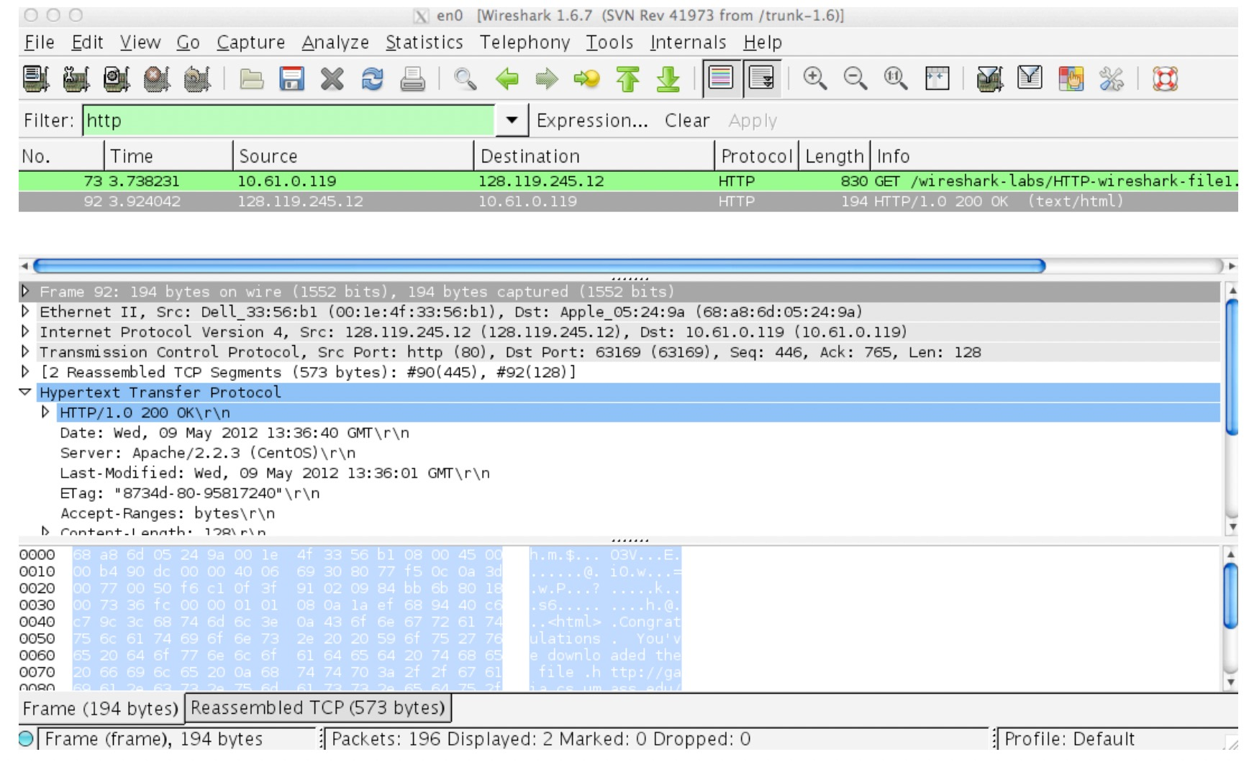
The Basic HTTP GET/response interaction

Slide 5
The Basic HTTP GET/response interaction
For this particular file, the gaia.cs.umass.edu server is setting the file’s last-modified time to be the current time, and is doing so once per minute.
Thus, if you wait a minute between accesses, the file will appear to have been recently modified, and hence your browser will download a “new” copy of the document.

Slide 6
Q1-Q7
1. Is your browser running HTTP version 1.0 or 1.1? What version of HTTP is the server running?
2. What languages (if any) does your browser indicate that it can accept to the server?
3. What is the IP address of your computer? Of the gaia.cs.umass.edu server?
4. What is the status code returned from the server to your browser?
5. When was the HTML file that you are retrieving last modified at the server?
6. How many bytes of content are being returned to your browser?
7. By inspecting the raw data in the packet content window, do you see any headers within the data that are not displayed in the packet-listing window? If so, name one.

Slide 7
The HTTP CONDITIONAL GET/response interaction
• Start up your web browser, and make sure your browser’s cache is cleared.
• Start up the Wireshark packet sniffer.
• Enter the following URL into your browser http://gaia.cs.umass.edu/wireshark-labs/HTTP-wireshark-file2.html
• Quickly enter the same URL into your browser again (or simply select the refresh button on your browser)
• Stop Wireshark packet capture, and enter “http” in the display-filter-specification window

Slide 8
Q8-Q11
8. Inspect the contents of the first HTTP GET request from your browser to the server. Do you see an “IF-MODIFIED-SINCE” line in the HTTP GET?
9. Inspect the contents of the server response. Did the server explicitly return the contents of the file? How can you tell?
10. Now inspect the contents of the second HTTP GET request from your browser to the server. Do you see an “IF-MODIFIED-SINCE:” line in the HTTP GET? If so, what information follows the “IF-MODIFIED-SINCE:” header?
11. What is the HTTP status code and phrase returned from the server in response to this second HTTP GET? Did the server explicitly return the contents of the file? Explain.

Slide 9
Retrieving Long Documents
• Start up your web browser, and make sure your browser’s cache is cleared, as discussed above.
• Start up the Wireshark packet sniffer.
• Enter the following URL into your browser
http://gaia.cs.umass.edu/wireshark-labs/HTTP-wireshark-file3.html
• Stop Wireshark packet capture, and enter “http” in the display-filter-specification window.

Slide 10
Retrieving Long Documents
In the packet-listing window, you should see your HTTP GET message, followed by a multiple-packet TCP response to your HTTP GET request.
The single HTTP response message is broken into several pieces by TCP, with each piece being contained within a separate TCP segment.
Itis indicated by the “TCP segment of a reassembled PDU” in the Info column of the Wireshark display.

Slide 11
Q12-Q15
12. How many HTTP GET request messages did your browser send? Which packet number in the trace contains the GET message for the Bill or Rights?
13. Which packet number in the trace contains the status code and phrase associated with the response to the HTTP GET request?
14. What is the status code and phrase in the response?
15. How many data-containing TCP segments were needed to carry the single HTTP response and the text of the Bill of Rights?

Slide 12
HTML Documents with Embedded Objects
• Start up your web browser, and make sure your browser’s cache is cleared, as discussed above.
• Start up the Wireshark packet sniffer
• Enter the following URL into your browser http://gaia.cs.umass.edu/wireshark-labs/HTTP-wireshark-file4.html.
• Stop Wireshark packet capture, and enter “http” in the display-filter-specification window, so that only captured HTTP messages will be displayed.

Slide 13
HTML Documents with Embedded Objects
• The two images are referenced in the base HTML file. That is, the images themselves are not contained in the HTML; instead the URLs for the images are contained in the downloaded HTML file.
• Your browser will have to retrieve these logos from the indicated web sites.

Slide 14
Q16 & Q17
16. How many HTTP GET request messages did your browser send? To which Internet addresses were these GET requests sent?
17. Can you tell whether your browser downloaded the two images serially, or whether they were downloaded from the two web sites in parallel? Explain.

Slide 15
HTTP Authentication
• Make sure your browser’s cache is cleared, as discussed above, and close down your browser. Then, start up your browser.
• Start up the Wireshark packet sniffer.
• Enter the following URL into your browser
http://gaia.cs.umass.edu/wireshark-labs/protected_pages/HTTP-wireshark_x0002_file5.html
Type the requested user name and password into the pop up box. The username is “wireshark-students” (without the quotes), and the password is “network” (without the quotes).
• Stop Wireshark packet capture, and enter “http” in the display-filter-specification window.

Slide 16
Q18 & Q19
18. What is the server’s response (status code and phrase) in response to the initial HTTP GET message from your browser?
19. When your browser’s sends the HTTP GET message for the second time, what new field is included in the HTTP GET message?

